Slide 1
Patterns & Best Practices For Moving From RDBMS to Azure Storage
DotNetConf 2013

Slide 2
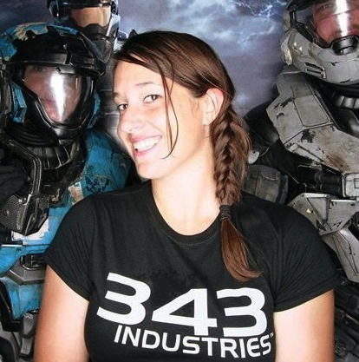
Caitie McCaffrey
Software Development Engineer
343 Industries
@CaitieM20
CaitieM.com

Slide 3


Notes:
I joined 343 in 2010 as a Web Services Engineer working on “projects & experiences” aka Halo 4.
We inherited the Halo Services Stack (IIS & SQL)
For Halo 4 we decided to build our Game Services in Azure
We moved from a totally relational one database world to the cloud and its non-relational storage.

Slide 4
Azure Storage
Blob - Unstructured Binary
Table - Structured Non Relational
SQL Database - Relational Storage
Notes:
Azure Storage consists of 3 storage options

Slide 5
Azure Table
“Windows Azure tables are ideal for storing structured, non-relational data.”
Notes:
Non-relational = NoSQL
Data is replicated 3 times
Automatically Scales Out

Slide 6
Azure Table Structure
Tables: Collection of Entities
Entities: Set of Properties
Properties: Name Value Pair
Notes:
Tables – collection of entities, no schema on entities
Entities – Set of Properties Similar to database row, Identified Uniquely by PartitionKey and RowKey
Properties – Name Value Pair

Slide 7
Entities
Partition Key: identifies which partition an entity belongs to
Row Key: uniquely identifies an entity in a partition
Timestamp: last time entity was modified
Notes:
Parition Key – string that identifies which partition an entity belongs to
Row Key – string that uniquely identifies an entity in a partition
Timestamp – DateTime Last time entity was modified
Partition Key + Row Key = Unique Identifier (single clustered index in table)
Sorted by partition key in ascending order & then row key in ascending order

Slide 8
Entities & Queries
Azure Table supports
ONLY ONE
Key per Entity.
Partition Key + Row Key = Unique Identifier

Slide 9
Properties are Name Value Pairs
Type | Numerics | Date & Time | Binary | Character Strings | Other
Azure Table | Int32 | DateTime | byte[] | Strings (UTF 16 encoded Value) | Guid
 | Int64 |  |  |  | Bit
 | Double
SQL | BigInt |  |  |  | Bit
 | Int
 | SmallInt | Date |  | Char
 | TinyInt | DateTime |  | Text
 | Money | DateTime2 | Binary | Varchar
 | SmallMoney | DateTimeOffset | Image | Nchar
 | Numeric | SmallDateTime | VarBinary | Ntext
 | Float | Time |  | NVarChar
 | Decimal
 | Real

Slide 10
Table Partitions
Entities with the Same Partition Key
Azure Table service supports Batch Transactions on entities that are in the same Table and belong to the same Partition.
Notes:
Entity Group Transaction
Each Entity Appears once
Up to 100 Entities etc…
Putting entities in the same partition allows you to perform Transactions and get ACID support.

Slide 11
Table Partitions
Single Server handles all requests for a Single Partition
Notes:
Here’s the catch, entities in the same partition are all served from the same machine.
Transaction Support and Scale are in direct conflict in Azure Table

Slide 12
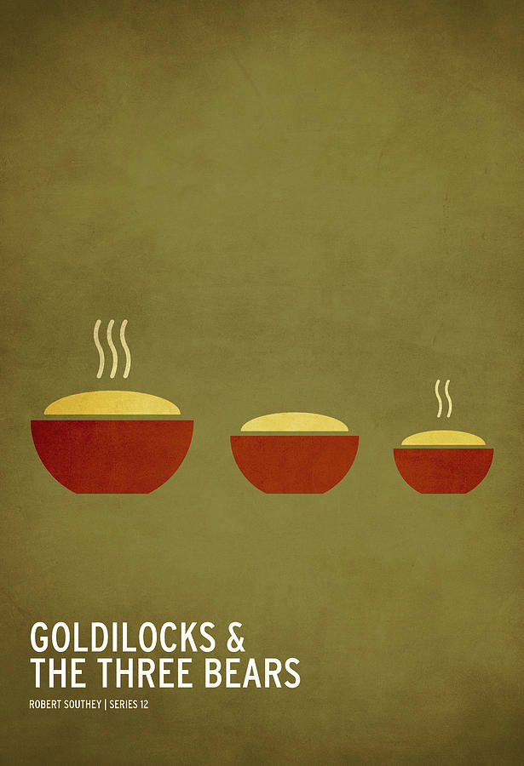
Goldilocks & Azure Storage
“This Partition Size is Too Big. It Won’t Scale!”
Notes:
Transactions in a NoSQL Database hooray!
I’ll put all my data in one Table Partition.
But then it didn’t scale

Slide 13
Goldilocks & Azure Storage
“This Partition Size is Too Small. Not Enough Transaction Support!”
Notes:
To fix the Scale problem Goldilocks then put every entity in her Table in its own Partition, but then she had no Transaction Support!

Slide 14
Goldilocks & Azure Storage
“This Partition Size is Just Right! Scale & Just Enough Transaction Support”
Notes:
Finally Goldilocks sat down and thought about her application and data needs, and came up with a way to partition her data so she got the transaction support she needed, and the scale she desired.

Slide 15
Moral of the Story:
Structure Data for
SCALE &
CONSISTENCY

Slide 16
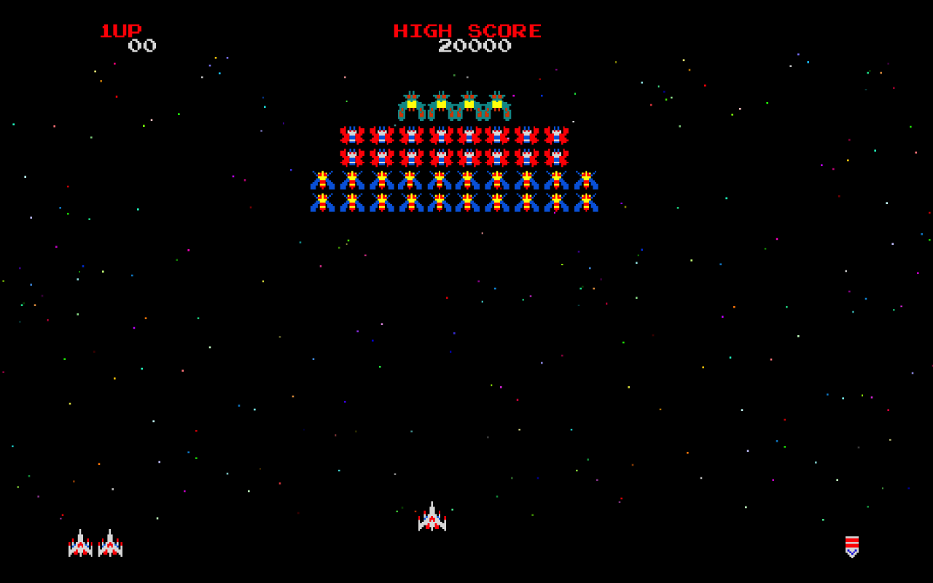
Simple Stats Example
Notes:
Players interact with your game potentially from multiple devices
Players have a unique Identity
Want to keep statistic totals for players in your game
Also want players to be able to see stats for individual games.
Statistics are uploaded at game end

Slide 17

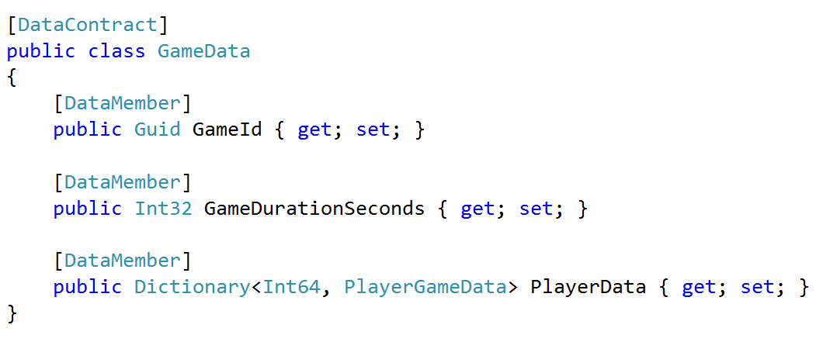
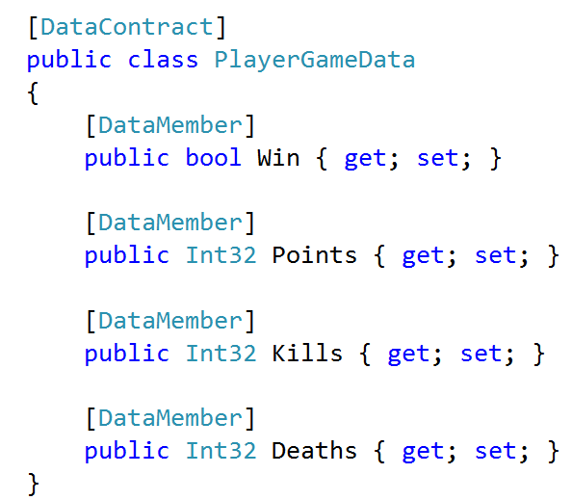
Simple
Stats:
Stats
Data

Slide 18
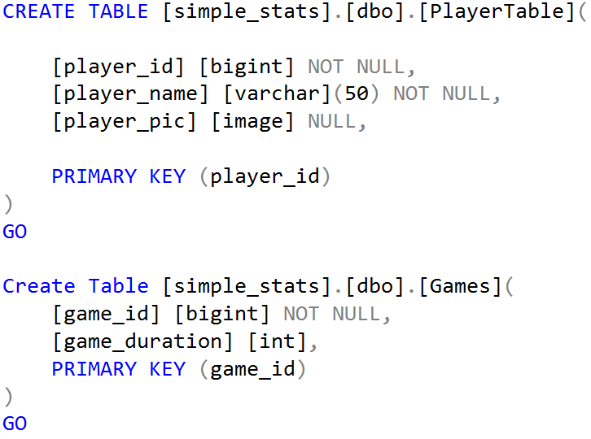
Simple Stats: SQL

Slide 19
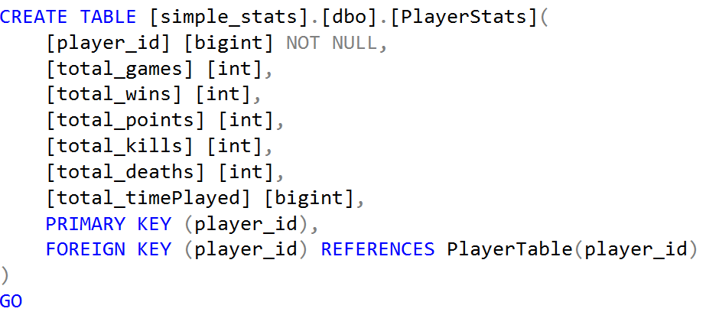
Simple Stats: SQL

Slide 20
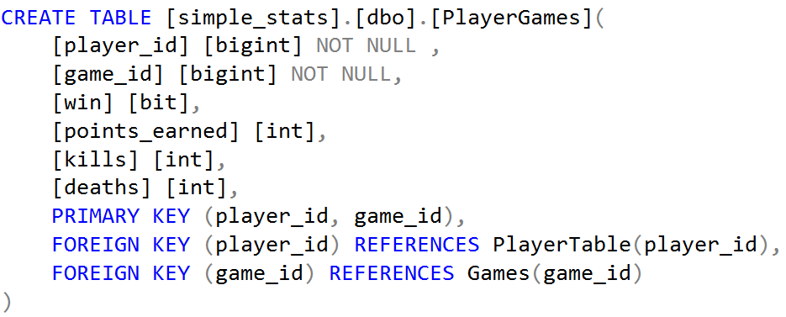
Simple Stats: SQL

Slide 21
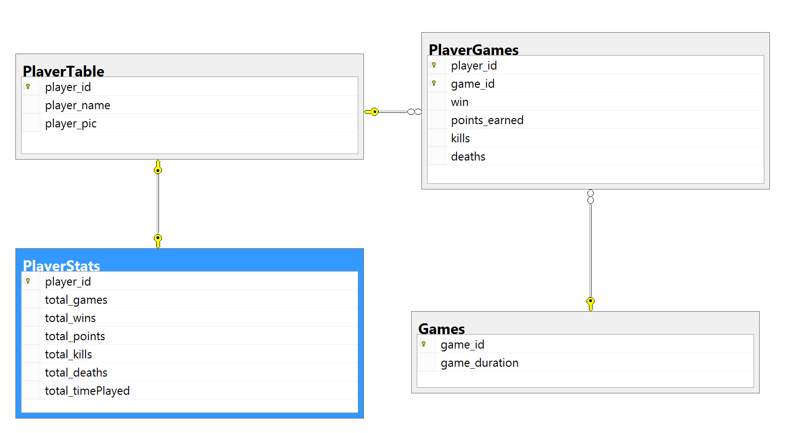
Simple Stats: SQL

Slide 22
Simple Stats: Azure Storage
What Transactions do I want?
Totals & Game Data Both Written
What Queries do I need?
Total player statistics
All games a player has played
Show stats for single game
How Do I Partition The Data?
Game Id or Player Id
Notes:
Choose a Partition Key
Games or Player
What Transactions do we want
On game end, update player totals & ensure game data is written
Queries
Show Player Statistics
Show me all the games I’ve played
Show me statistics for a single game.

Slide 23
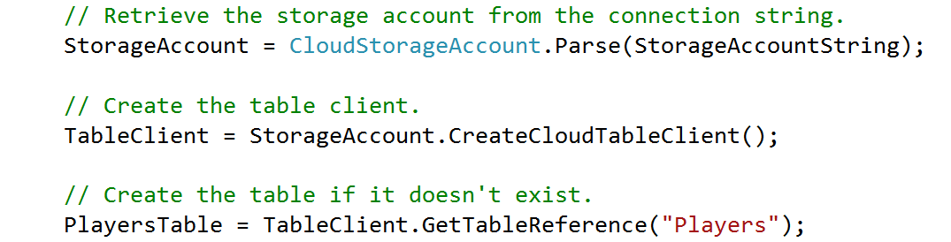
Simple Stats: Creating a Table
Notes:
// Retrieve the storage account from the connection string.
StorageAccount = CloudStorageAccount.Parse(StorageAccountString);
// Create the table client.
TableClient = StorageAccount.CreateCloudTableClient();
// Create the table if it doesn't exist.
PlayersTable = TableClient.GetTableReference("Players");

Slide 24
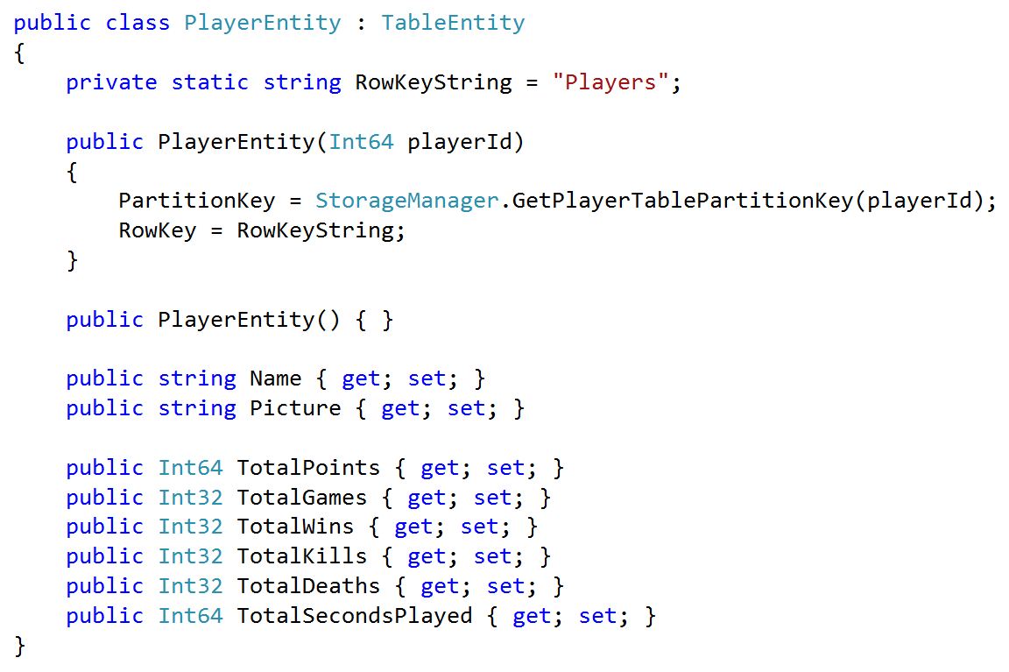
Simple Stats: Player Entity

Slide 25
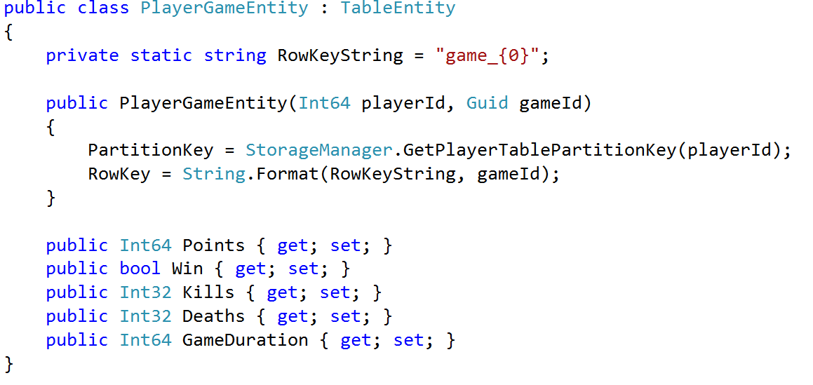
Simple Stats: PlayerGameEntity

Slide 26
Code Break
“We Don’t Know How To Make Perfect Software”
~Nathan Marz
Notes:
Code Break
Databases CRUD (Create, Read, Update, Delete)
Immutable Data No: Update & Delete
Why?
Code has bugs
People make mistakes
Having an Immutable Data Source means can always replay events
Also gives you audit logging. (How did we get to the state we are in)

Slide 27
Code Break
The Worst Error Is Data Loss or Data Corruption. It is Unrecoverable.

Slide 28
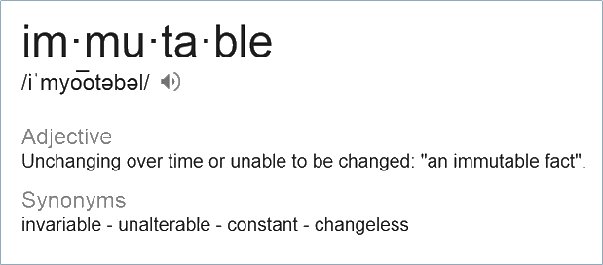
Data Immutability
Create
Read
Update
Delete

Slide 29
Code Break: Immutability
Data Immutability
Create
Read
Update
Delete
Create
Read
Update
Delete

Slide 30
Immutability in the Real World
“Event” Entities: Source of Truth is Immutable
Aggregate “View” Entities: use all of CRUD.
Notes:
Purely Immutable data stores aren’t practical
Immutable Data Rows & View Rows
View Rows
Can be updated & deleted
Can always be reconstructed from the Immutable data rows

Slide 31
More Immutability Benefits
Idempotent Writes to a Partition
Flexibility to add new views later
Data Audit Log

Slide 32
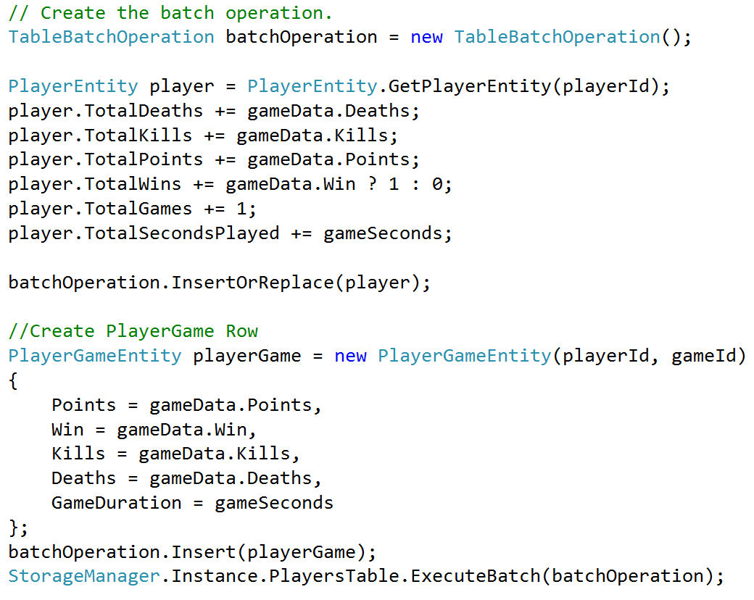
Simple Stats: Process Stats

Slide 33
Show What Partition Would Look Like

Slide 34
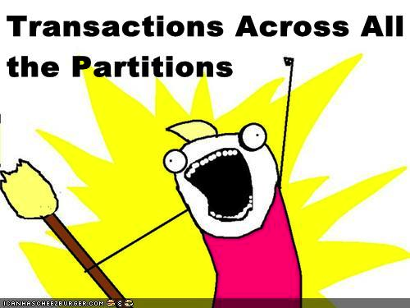
Distributed Transactions
Notes:
What about multiplayer games. I need to ensure all the stats write for all the players. But I can only get transactions in one Partition.

Slide 35
Google Spanner
“Spanner is Google’s scalable, multi-version, globally distributed, and synchronously-replicated database. It is the first system to distribute data at global scale and support externally-consistent distributed transactions.”
~James C. Corbett et al

Slide 36
Google Spanner
““The key enabler of these properties is a new TrueTimeAPI and its implementation…using multiple modern clock references (GPS and atomic clocks).”
~James C. Corbett et al
Notes:
“GPS reference-source vulnerabilities include antenna and receiver failures, local radio interference, correlated failures (e.g., design faults such as incorrect leapsecond handling and spooﬁng), and GPS system outages.
Atomic clocks can fail in ways uncorrelated to GPS and each other, and over long periods of time can drift significantly due to frequency error.”“TrueTime is implemented by a set of time master machines per datacenter and a timeslave daemon per machine. The majority of masters have GPS receivers with dedicated antennas;”

Slide 37
Distributed
Transactions
Are Hard
Notes:
“GPS reference-source vulnerabilities include antenna and receiver failures, local radio interference, correlated failures (e.g., design faults such as incorrect leapsecond handling and spooﬁng), and GPS system outages.
Atomic clocks can fail in ways uncorrelated to GPS and each other, and over long periods of time can drift significantly due to frequency error.”“TrueTime is implemented by a set of time master machines per datacenter and a timeslave daemon per machine. The majority of masters have GPS receivers with dedicated antennas;”

Slide 38
Saga Pattern
Transaction Model for Distributed Transactions or Long Lived Activities
Notes:
Transaction Model for Long Lived Activities or Distributed Transactions.
Good For Long-Lived Transactions or Distributed Transactions where ACID and 2 phase commit can’t be used.
No Centralized Coordination, No Centralized State

Slide 39
“Saga is a Failure Management Pattern”
~Clemens Vasters
Notes:
Work is split into component Transactions
Each component transaction has a compensating transaction
On failure compensation transaction is executed
Compensation Transaction does not necessarily restore DB to previous state, but from a semantic point of view it has been rolled back

Slide 40
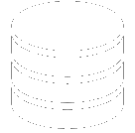
Game Stats
Store Stats
Player One
Store Stats
Player Two
Store Stats
Player Three
Store Stats
Player Four
Notes:
Player Partitions can be distributed across multiple nodes.
We can guarantee Transaction behavior for saving a single players stats
Never want to count stats twice.
If one Player fails to save replay stats across whole system, until everyone returns success.
Because our writes are Idempotent we can do this.

Slide 41
Game Stats
Store Stats
Player One
Store Stats
Player Two
Store Stats
Player Three
Store Stats
Player Four
Notes:
If one or more players fail to write their stats bc storage goes down etc.. Then we have an inconsistent state. Player 1, 2 & 4 have the stats data but player 3 does not

Slide 42
Store Stats
Player One
Store Stats Player Two
Store Stats Player Three
Store Stats
Player Four
Compensate
Player One
Compensate
Player Two
Compensate
Player Three
Compensate
Player Four
Notes:
Notify the other players that you failed to write. They should take a compensating transaction to fix this.
In Simple Stats our compensating transaction could be to do nothing. If we can re-try the processing of the Game Stats

Slide 43
Game Stats
Store Stats
Player One
Store Stats
Player Two
Store Stats
Player Three
Store Stats
Player Four
Notes:
Because we have Idempotent writes we can just replay the data. 3 of the writes will fail, but they will fail with an exception that tells us that this data has already been stored. Player Three will succeed to write, and therefore the world is now in a consistent state.

Slide 44
Summary
Tradeoff: Consistency vs Scale

Slide 45
Summary
Make Data
Immutable

Slide 46
Summary
Saga Pattern
for Distributed Transactions

Slide 47
Summary
Saga Pattern
for Distributed Transactions
Make Data
Immutable
Tradeoff: Consistency vs Scale

